Slide 1
DIP Final

Slide 2
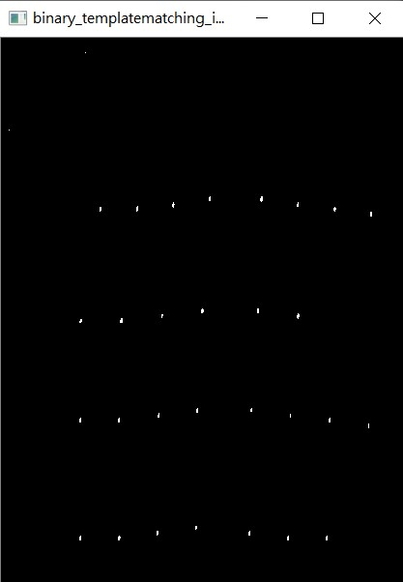

Slide 3
E
D
C
B
A
G
F
E
D
C

Slide 4
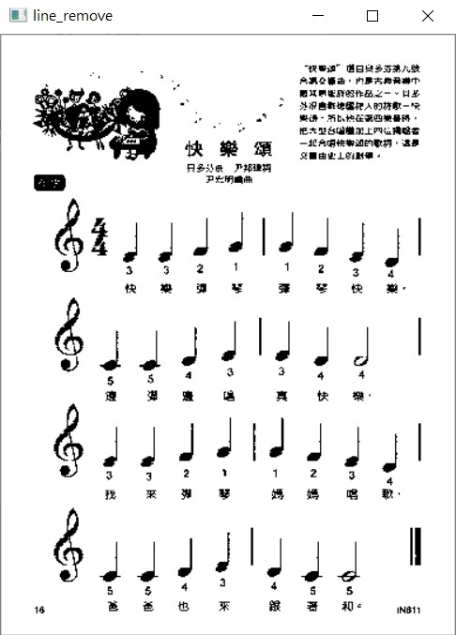

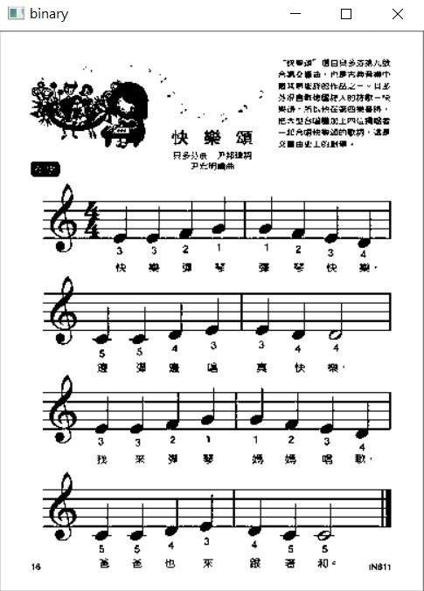
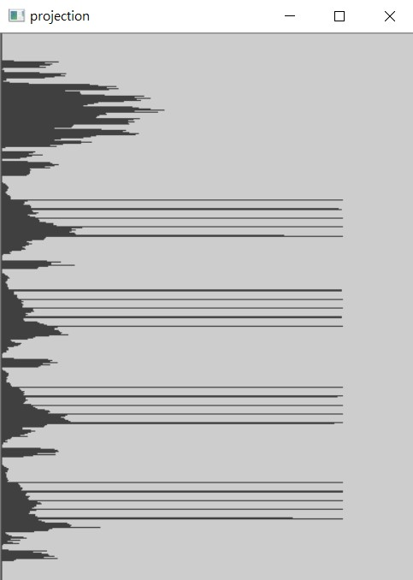

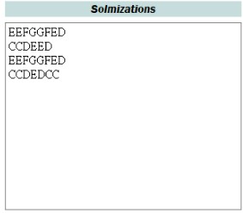
Template matching
+ binarization
Line removing
Horizontal
projection
Preprocessing
Note location
Line only
Line location
Semantics

